Slide 1



Visualization in iTowns of Buildings Elegantly Stylized
Authors
Houssem Adouni
El-Hadi Bouchaour
Arnaud Grégoire
Rose Mathelier
Laurie Nino
Adel Ouhabi
Ludivine Schlegel
Notes:
rose

Slide 2

Introduction
PRESENTATION PROJECT
SCRUM
ANALYSIS
STYLE DEFINITION
Notes:
rose

Slide 3

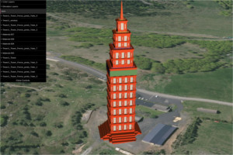
Presentation of the project
Load one or several 3D file (of various formats).
Transform its/their visual aspect(s) using a GUI.
Save the current style in VIBES format.
Load an existing style to re-apply it.
Project backers
Mathieu Bredif
Sidonie Chistophe
Alexandre Devaux
Vibes Style Visualisation
Notes:
rose

Slide 4
Summary
Project management
Analysis
Process and architecture
Results
Tests, integration and deployment
Conclusion

Slide 5

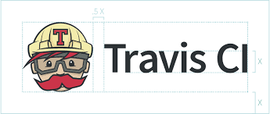


SCRUM methodology
Team :
Project manage by a group of seven student from ENSG-TSI
Houssem Adouni
El-Hadi Bouchaour
Arnaud Grégoire
Rose Mathelier (Scrum Master)
Laurie Nino
Adel Ouhabi
Ludivine Schlegel
Management tools :
Notes:
rose

Slide 6
SCRUM methodology
7 sprints
1 sprint = 1 week
Analysis and conception CI/CD Basic stylization
Edge extraction and stylization Texture application
BD Topo Sketchy edges Environment
1
3
5
2
4
20XX
6 - 7
Architecture set-up Save/Load Style format
BATI3D Object geolocation Layer management
Finalization, debug, documentation, reports, presentation
Notes:
rose

Slide 7
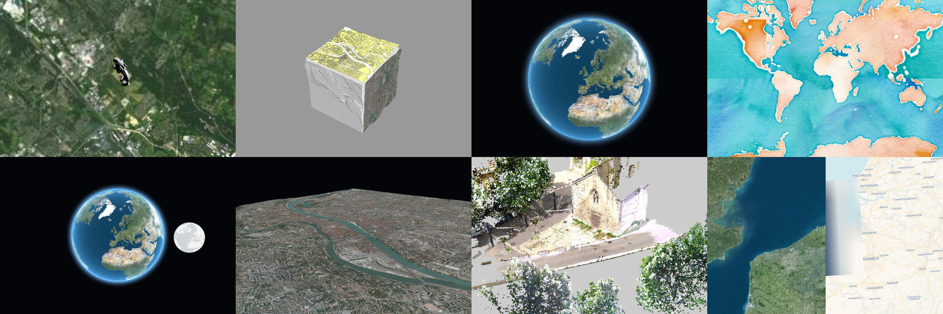
Analysis of iTowns and the PLU++ projects
iTowns project :
The project have to be included into the architecture of iTowns project.
Two sorts of development can be carried out in iTowns :
Develop a new example, based on the existing classes of the core of iTowns.
Add new functionalities directly to the core.
Notes:
ludivine

Slide 8
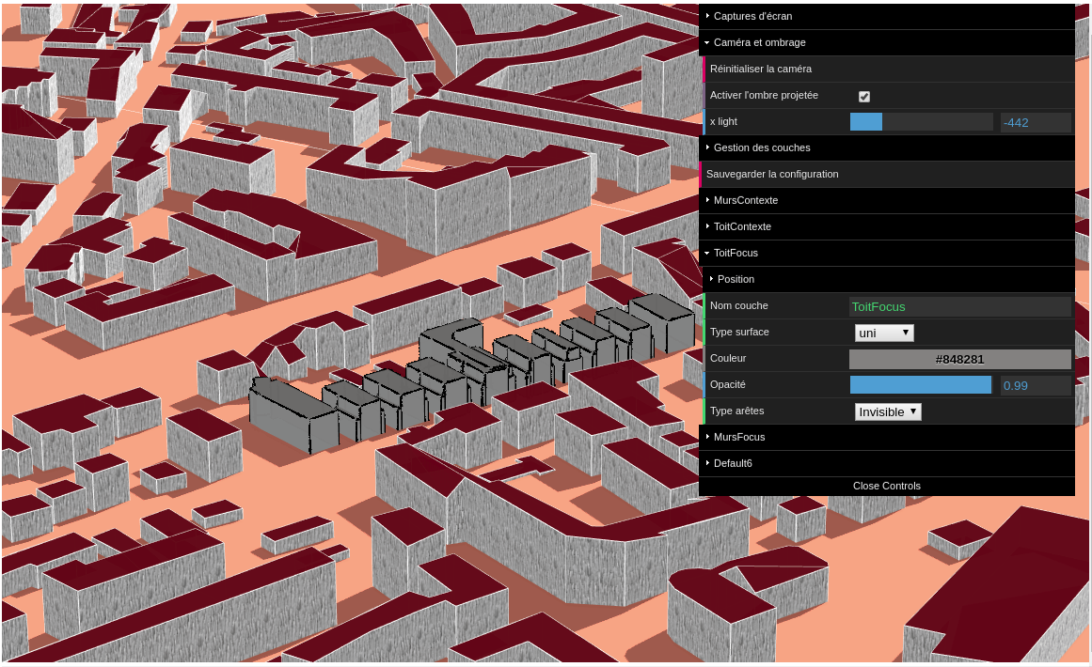
Analysis of iTowns and the PLU++ projects
PLU++ project :
Project developed in 2016 by Anouk Vinesse
Tool of 3D building stylization
Using Three.js
Understand how these are done :
Loading an OBJ file.
Applying a style to a mesh.
Changing this style dynamically using a user
interface (dat.GUI).
Notes:
laurie

Slide 9
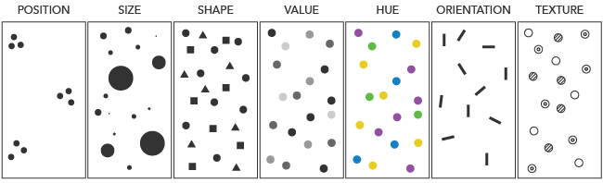
Definition of a style
Visual variables:
In the book "Semiologie Graphique" written by Jacques Bertin in 1967,
the style is defined as a graphical traduction of an information.
https://www.axismaps.com/guide/general/visual-variables/
Notes:
laurie

Slide 10
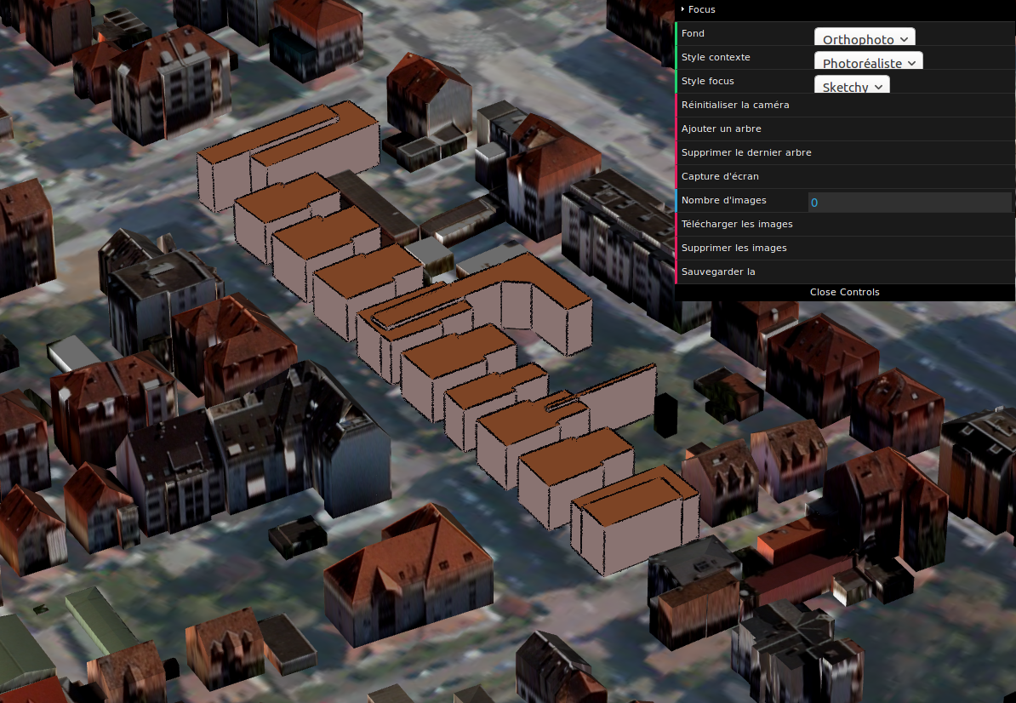
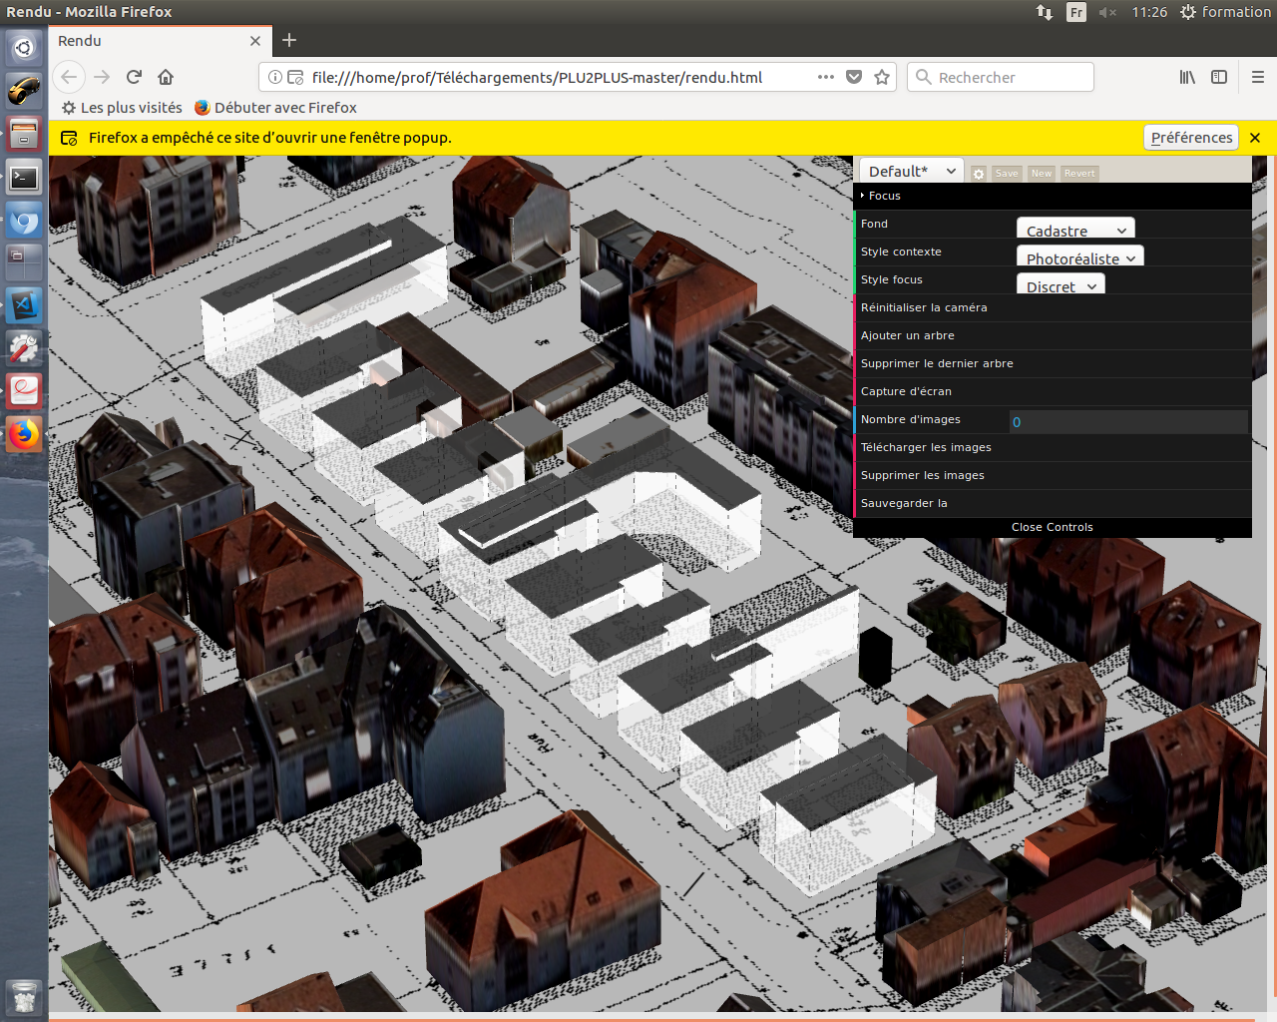
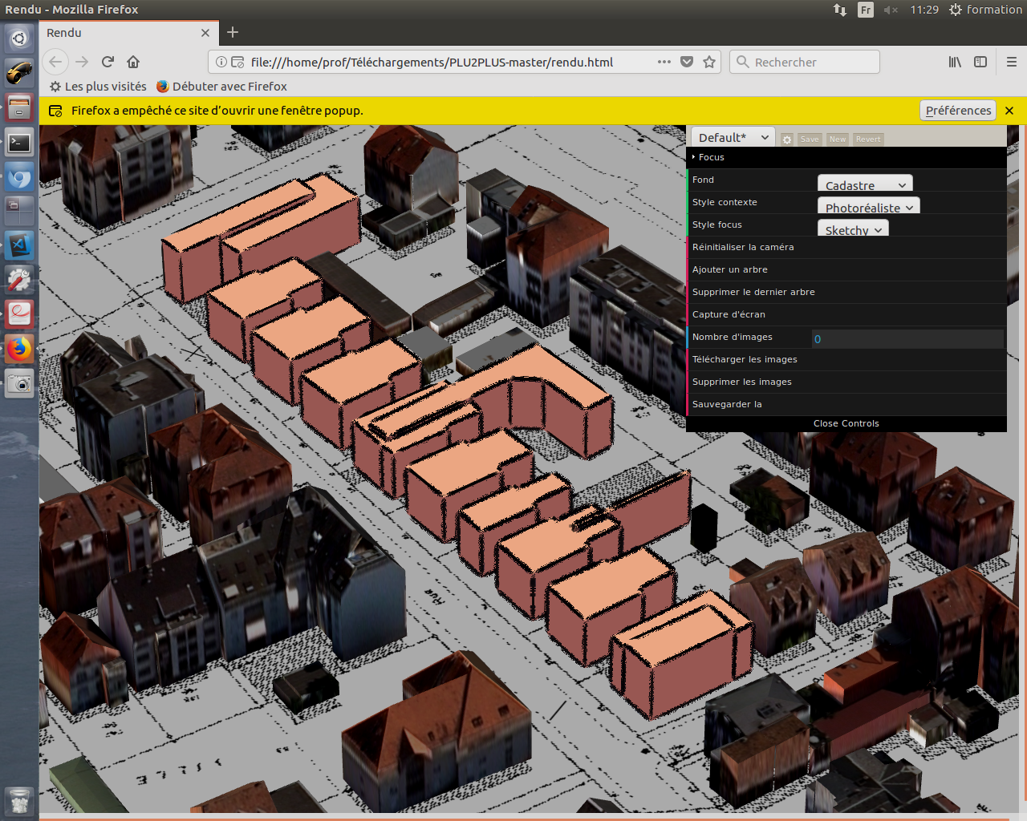
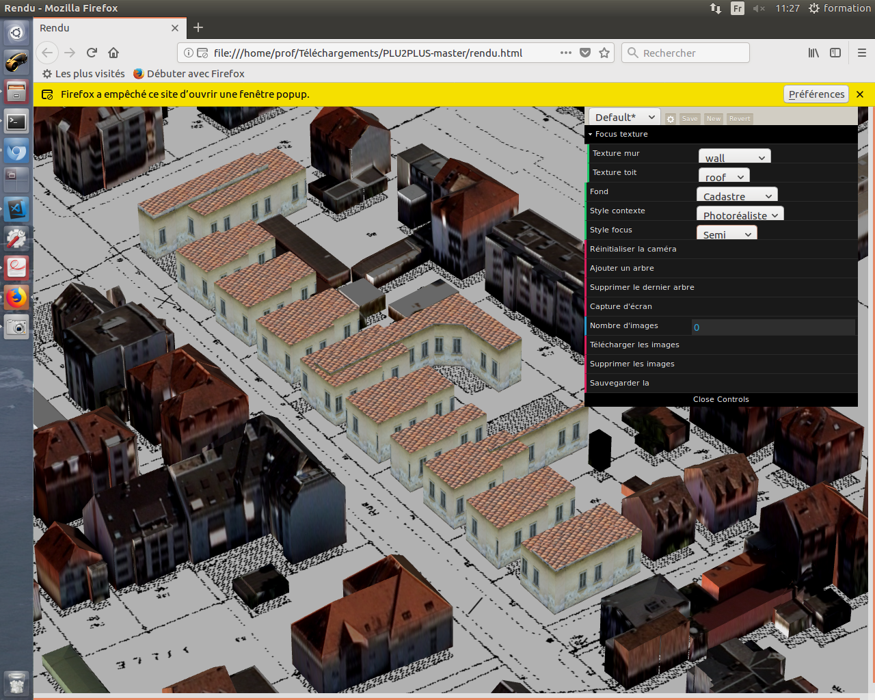
Definition of a style
Focus
There are two kind of representation
for buildings :
Photo-realistic (Contexte)
Abstract (Focus) :
Discret - Typical - Sketchy
Contexte
Notes:
laurie

Slide 11
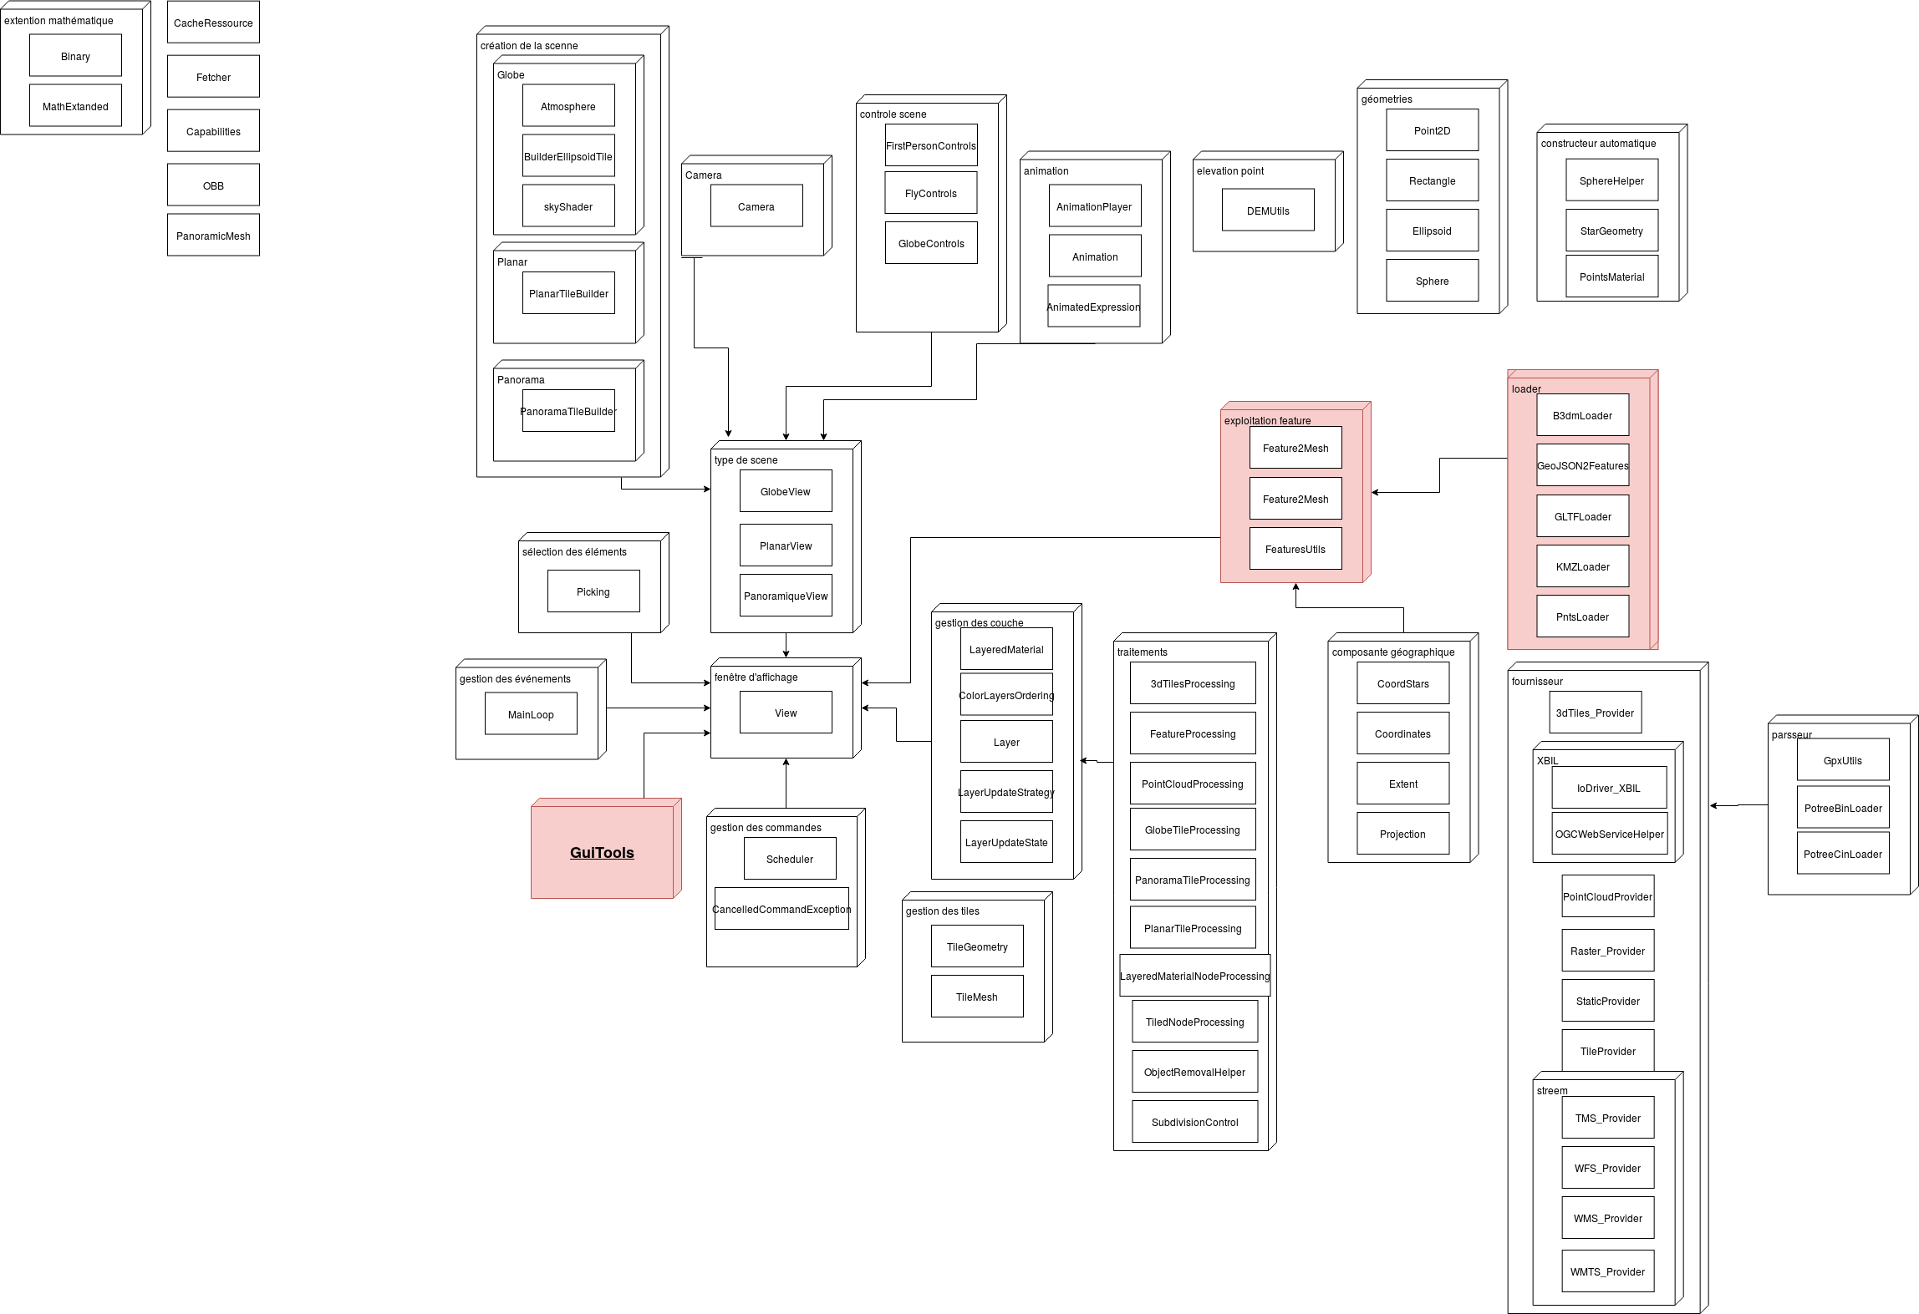
Process & Architecture
PROCESS
STYLE FORMAT
ARCHITECTURE
Notes:
adel

Slide 12
3D stylization process
Write and save .vibes file
Read .vibes file and apply style
Symbolizer
Stylize 3D object loading existing style
User
Symbolizer
Convert 3D object to mesh and display it
Create menu
Data loader
Symbolizer
User
User
Symbolizer
Change and save new style
User
Don’t load existing style
Apply default style
Instantiate iTowns and load 3D object
Notes:
adel

Slide 13
Style format
{ "edges": { "opacity": 1, "color": "#000000", "width": 0.5050859347597334, "style": "Continuous" }, "faces": [ { "name": "Tower1_Tower", "opacity": 1, "color": "#a06b6b", "emissive": "#614848", "specular": "#111111", "shininess": 31.55357142857143, "texture": "./textures/bricks.jpg", "textureRepeat": 0.1 }, { "name": "Tower1_window", "opacity": 1, "color": "#ffffff", "emissive": "#d4a9a9", "specular": "#f2dbdb", "shininess": 30, "texture": "./textures/glass.png", "textureRepeat": 1.5901250000000002 }, { ... } ] }
COMPLEX STYLE
JSON file : .VIBES
{ "edges": { "opacity": 1, "color": "#ed0606", "width": 2.525429673798667, "style": "Dashed", "dashSize": 0.2877972641178534, "gapSize": 0.05 }, "faces":[ { "opacity": 1, "color":"#dadeda", "emissive":"#938383", "specular":"#111111", "shininess":67.34479130129779, "texture":"./textures/bricks.jpg", "textureRepeat":0.374991231146966 } ] }
GENERIC STYLE
Notes:
arnaud

Slide 14
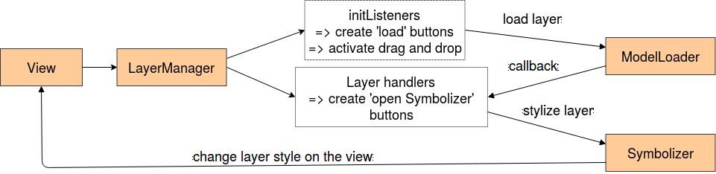
Architecture
The tool created should be usable on any example containing a 3D object on an instance of the globe.
Creation of new classes :
Class ModelLoader
Class Symbolizer
Class LayerManager
Creation of an example :
VibesTest.js, (linked to the HTML document) to call the previous classes.
Notes:
adel

Slide 15
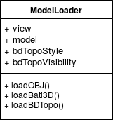
Architecture
ModelLoader.js
Create to loads different sorts of 3D objects.
These functions :
Convert the 3D object into a group of meshes
Call internal methods to load the object in iTowns
Final object (and its edges) stored in attribute model
Notes:
ludivine

Slide 16
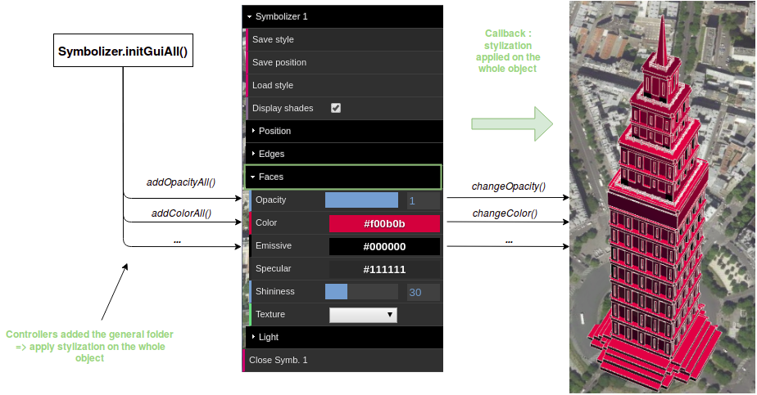
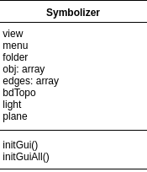
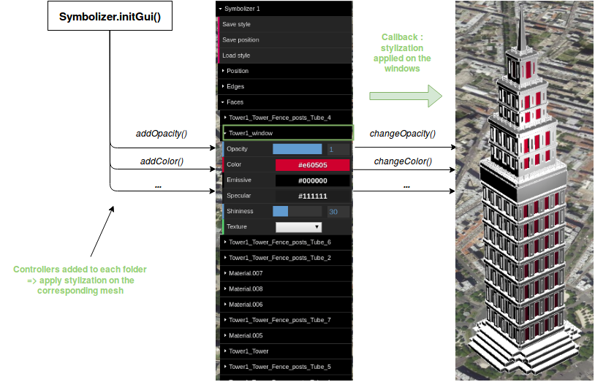
Architecture
Symbolizer.js
Callback :
Stylization applied on the whole object
This class carries all the stylization functionalities.
As a whole :
Controllers add the general folder
Callback :
Stylization applied the windows
Controllers add to each folder
Mesh by mesh :
Notes:
adel

Slide 17
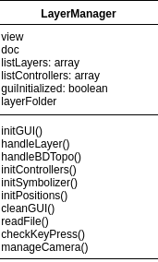
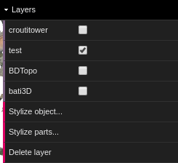
Architecture
LayerManager.js
Create to manage layer and user interface in the project.
The interest of this class is to provide
an interface similar those we can find in a GIS,
so the user can manipulate his layers.
Notes:
adel

Slide 18
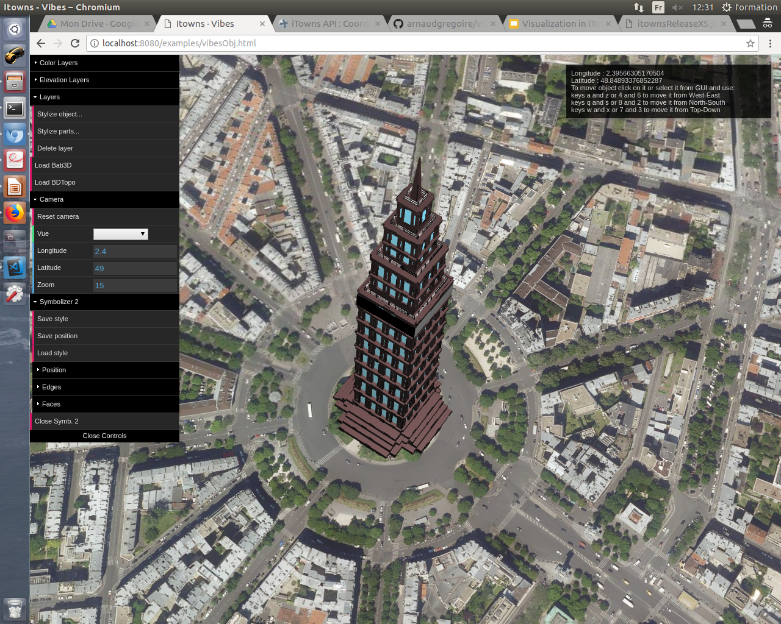
Results
BASIC FUNCTIONALITIES
ADVANCED FUNCTIONALITIES

Slide 19
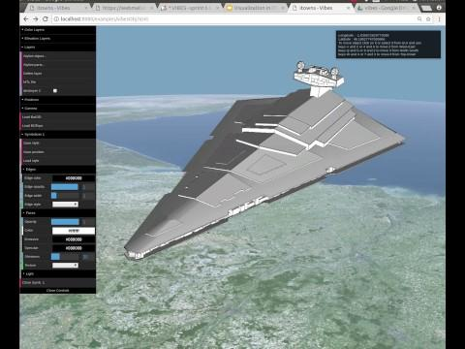
Basic functionalities
Possibility to load a 3D object in iTowns
OBJLoader
User interface to dynamically modify the stylization
Javascript library dat.GUI
Possibility to save and
load a style with .VIBES file
JSON file
Notes:
el hadi

Slide 20
Advanced functionalities
Layer management
Geolocation
Layer movements and transformations
Stylization
Edge stylization
Face stylization
Environment
Lights
Shadows
Camera
Loaders
OBJ Loader
BATI3D Loader
BD TOPO® Loader
Notes:
houssem

Slide 21
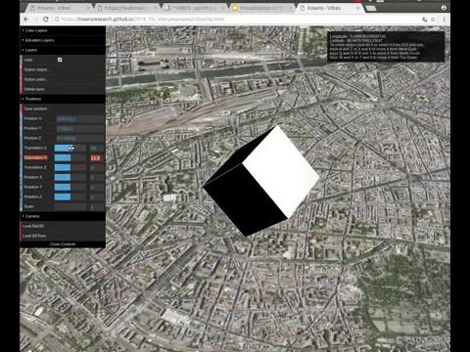
Advanced functionalities
Geolocation
Enter parameters to locate the object to stylize.
Adjust the chosen position with the sliders on the GUI.
(slight translations, rotations, scaling)
Move layers directly in the view with check keys.
JSON file : .GIBES
﻿{
"name":"croutitower",
"coordX":4202000,
"coordY":178000,
"coordZ":4779009,
"rotateX":-3.09
"rotateY":0.85
"rotateZ":-1.63
"scale":300
}
Notes:
houssem

Slide 22
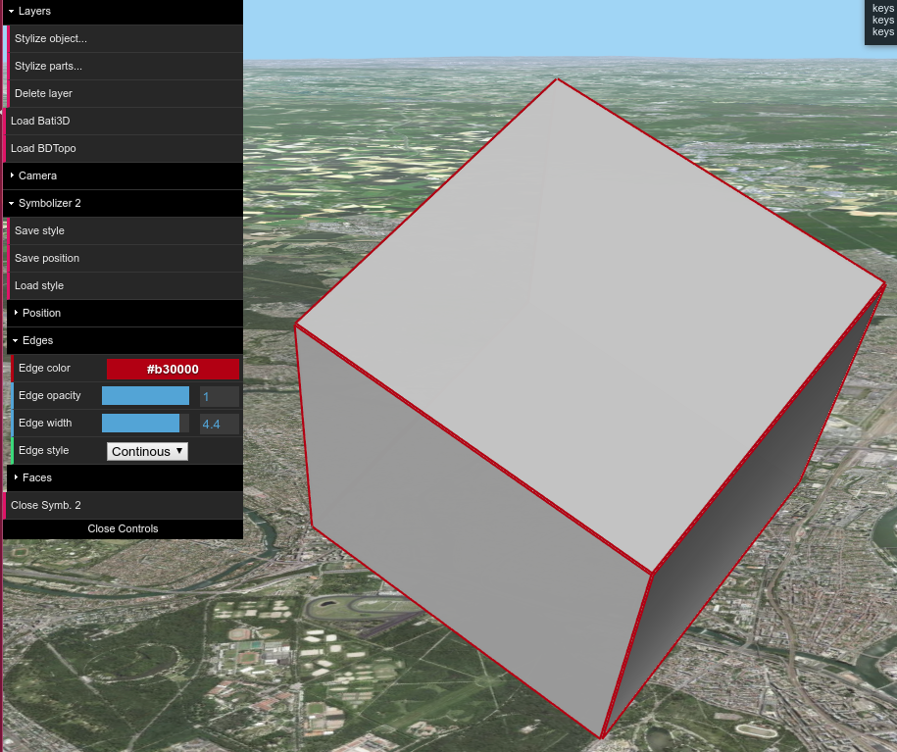
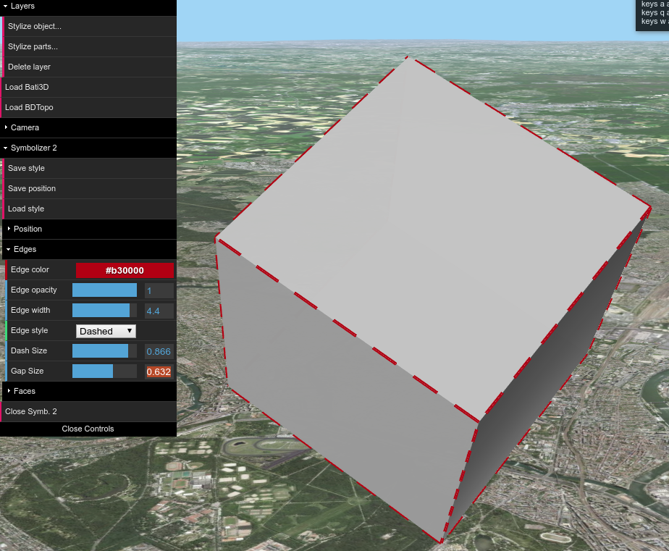
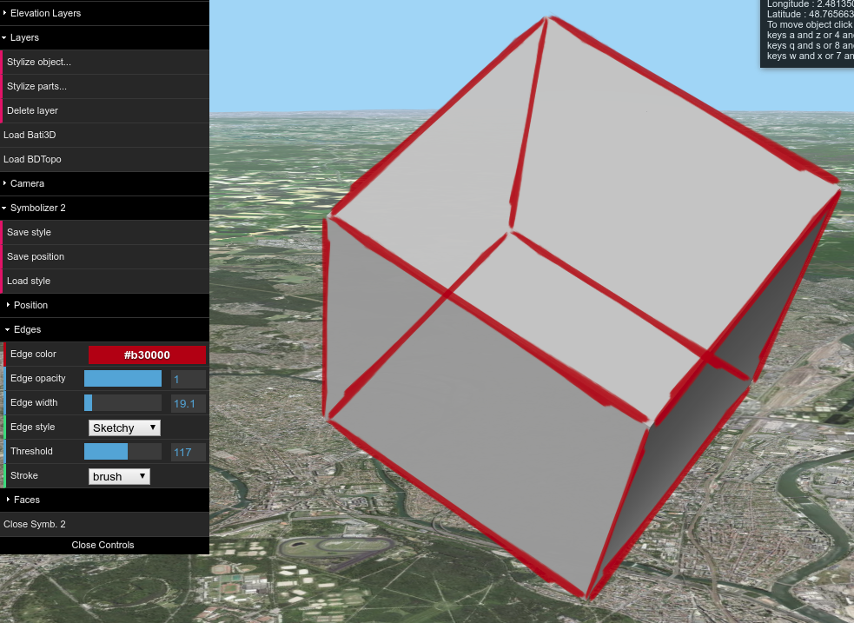
Advanced functionalities
Edges stylization
Extraction : THREE JS EdgesGeometry → THREE JS LineSegments
Stylization : opacity, color, width, style
Continuous
Dashed
Sketchy
Notes:
el hadi

Slide 23
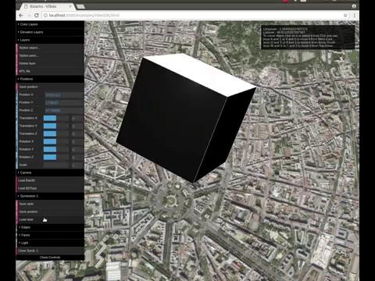
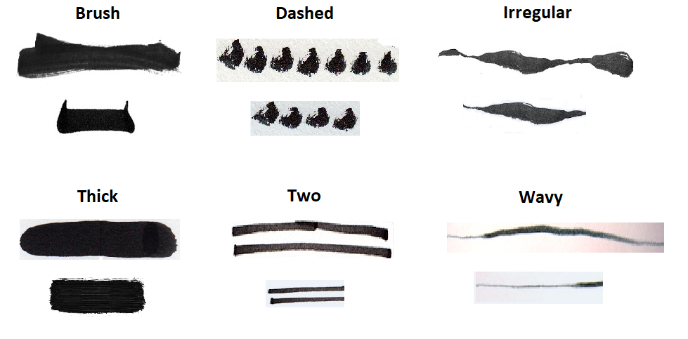
Advanced functionalities
Edges stylization
Texture sketchy :
Edge
(linear)
Rectangle
(planar)
Shader Material :
the rectangle always faces the camera
Notes:
rose

Slide 24
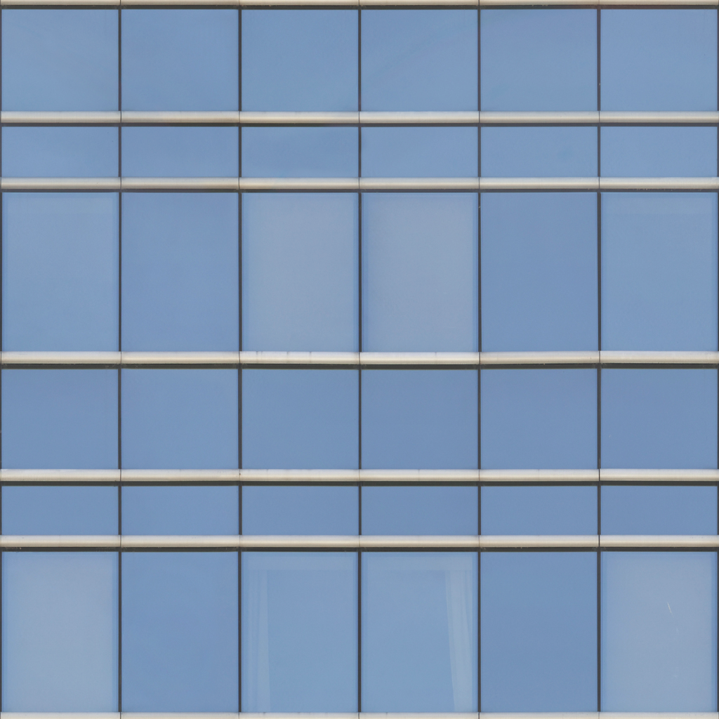
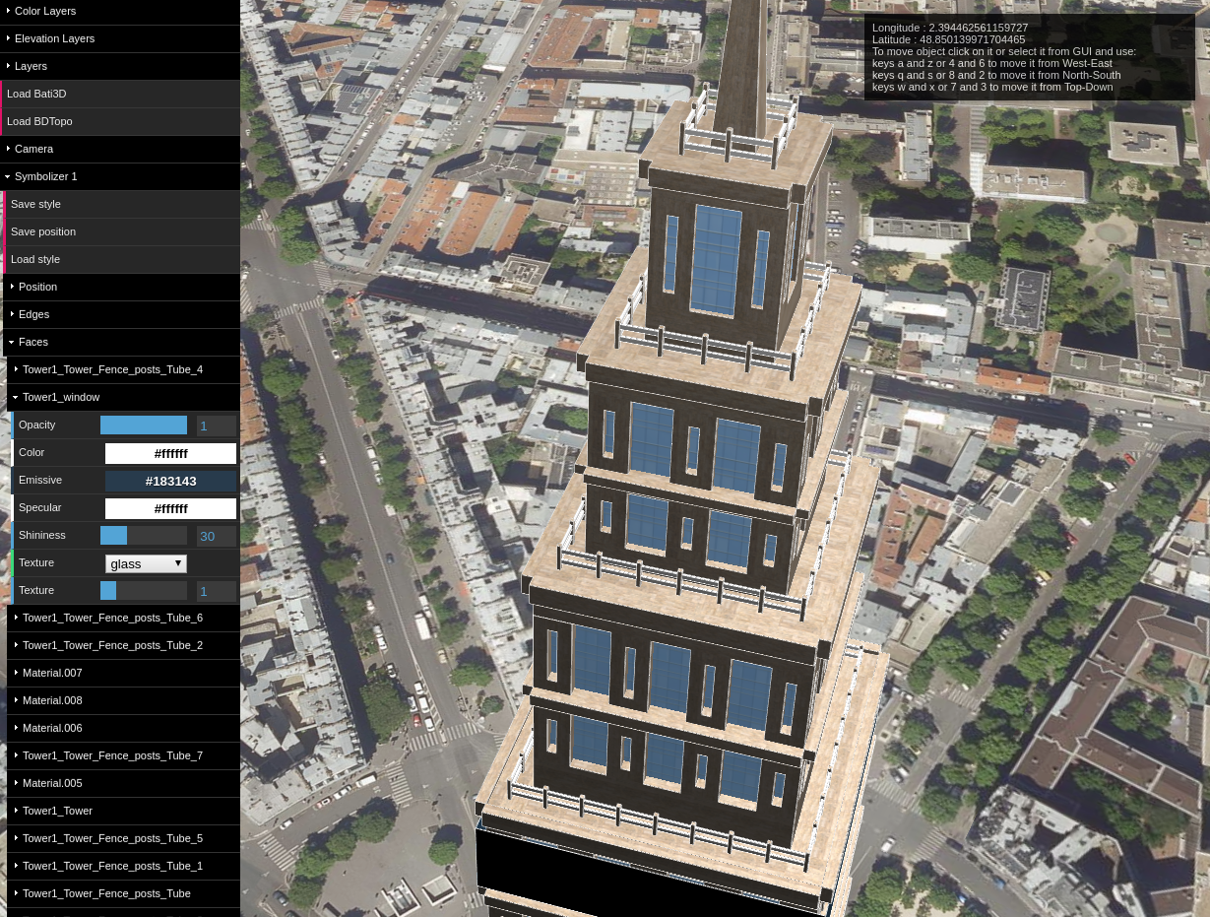
Advanced functionalities
Faces stylization
glass.png
Material :
opacity, color, emissive, specular, shininess
MTL stylization : MTLLoader
Face texturation : TextureLoader
Texture repetition
Shader application : ShaderMaterial
Vertex shader : ShaderName_vert.glsl
Fragment shader : ShaderName_frag.glsl
Uniforms : ShaderName_uni.json
(not yet implemented)
Notes:
laurie

Slide 25
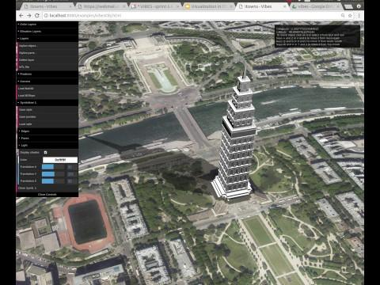
Advanced functionalities
Environment
Lights : THREE JS PointLight
1 Light / symbolizer
Shadows : ShadowMaterial
Huge Plane Object near ground
Material with transparency
1 shadow/symbolizer
Options :
Display shadow
Light position & color
Notes:
arnaud

Slide 26
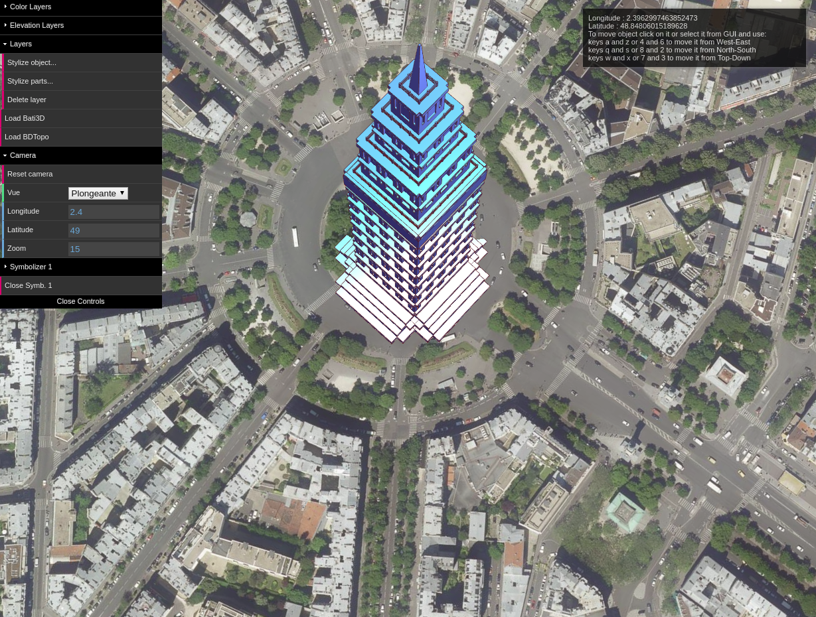
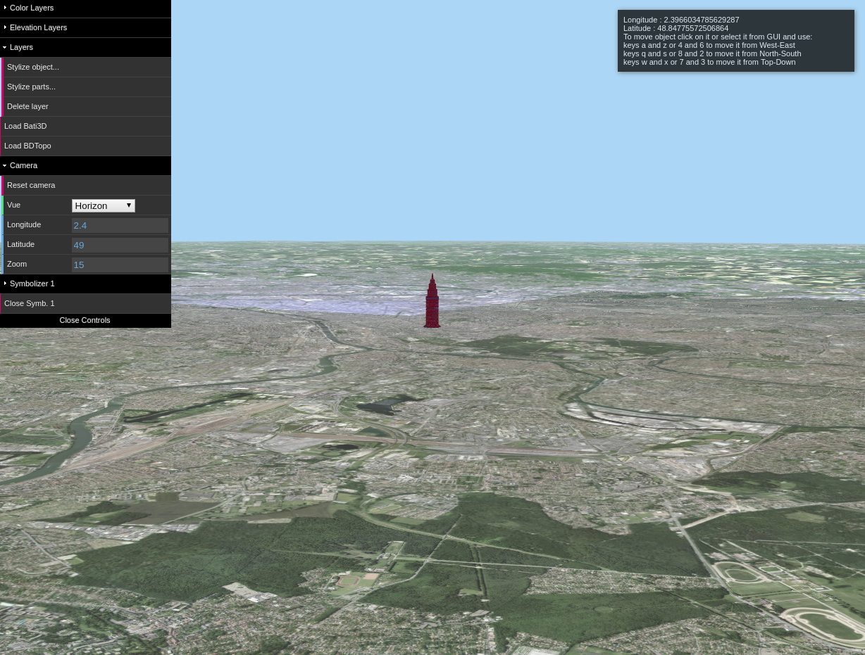
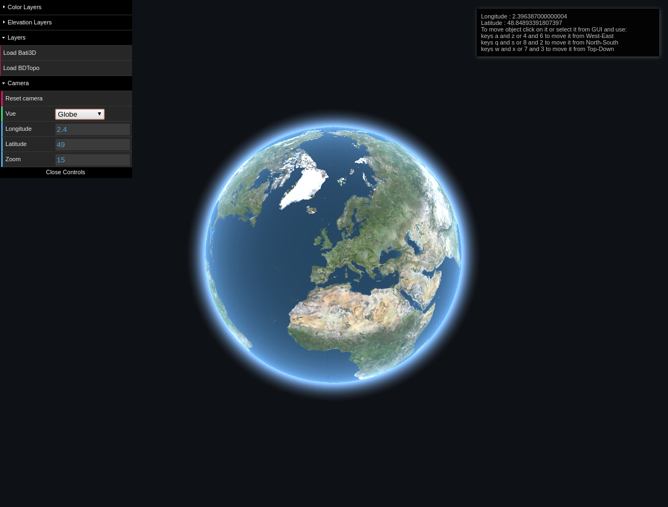
Advanced functionalities
Environment
Camera :
Follow the object movement
Modification of the camera parameters Longitude - Latitude - Zoom
Different points of view :
Immersive
Oblique
Global
Notes:
laurie

Slide 27
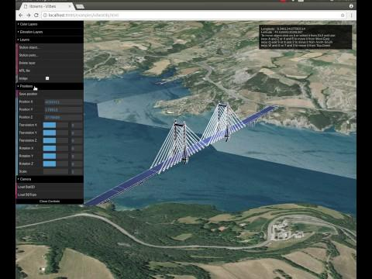
Advanced functionalities
Loader
Three different loaders :
OBJ Loader : npm package 'three-obj-loader'
BATI3D Loader : itowns-legacy
BDTOPO Loader : class Feature2MeshStyle
The BATI3D is an IGN production that gives the 3D building of France by 500mx500m tile (in the localization where the data exists).
The BD TOPO® is a 3D vector description of the elements of the territory and its infrastructures, of metric precision, exploitable on scales ranging from 1: 5 000 to 1: 50 000 .The BD TOPO® is accessible with a WFS flux.
(http://professionnels.ign.fr/bdtopo)
Notes:
ludivine

Slide 28
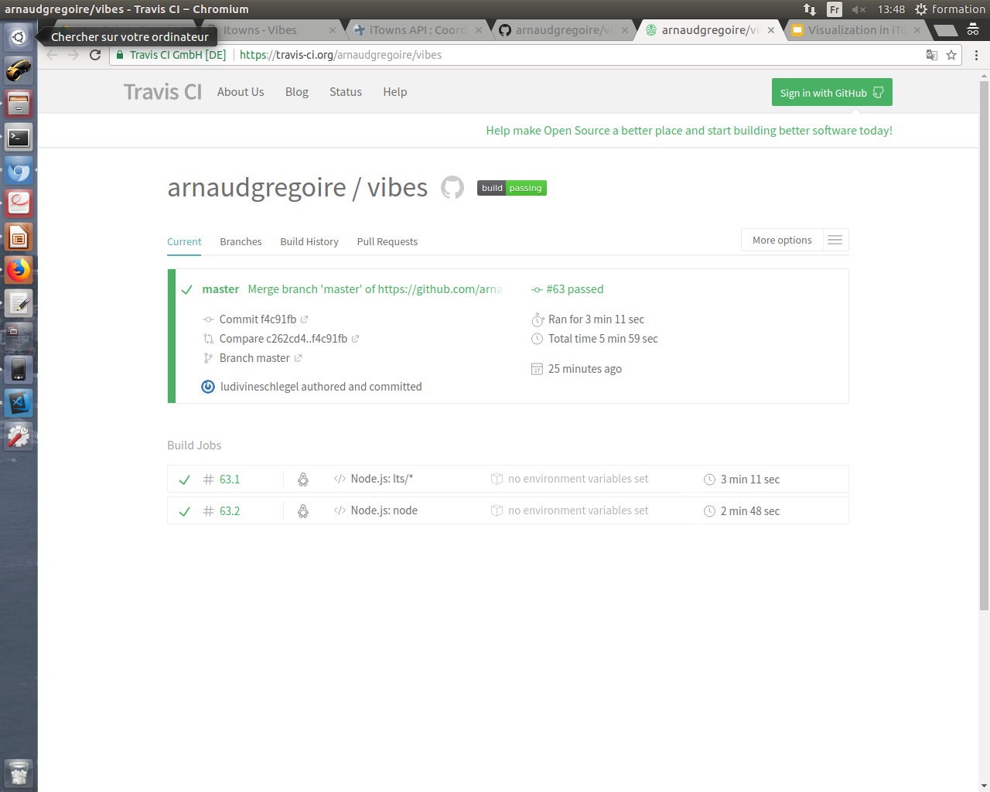
Tests, CI
& Deployment
UNIT TESTS
FUNCTIONAL TESTS
CONTINUOUS INTEGRATION & DEPLOYMENT

Slide 29
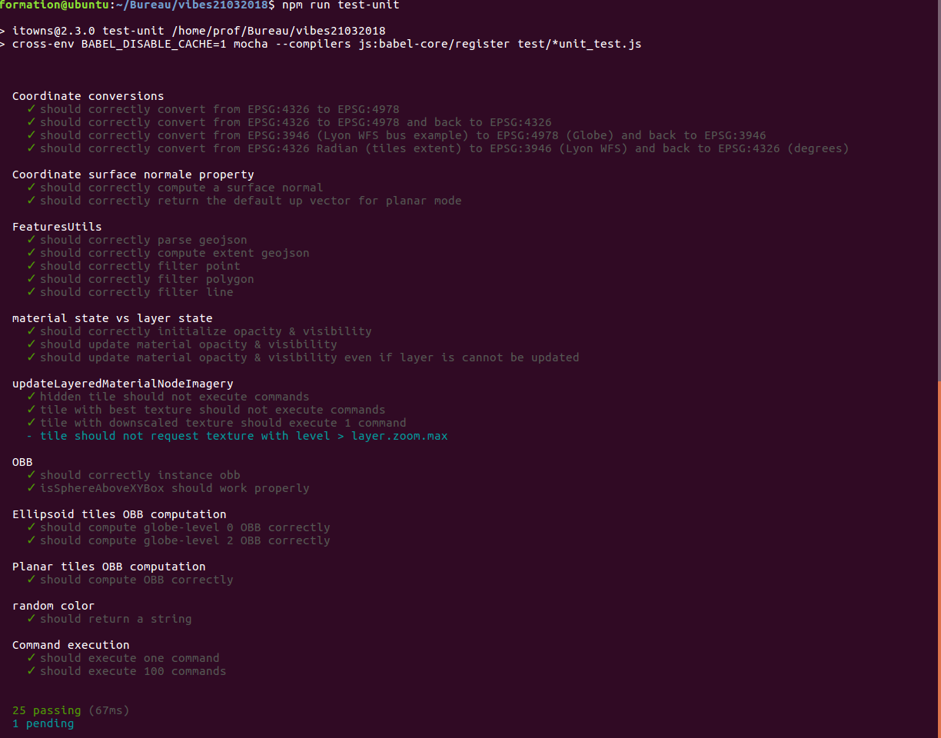
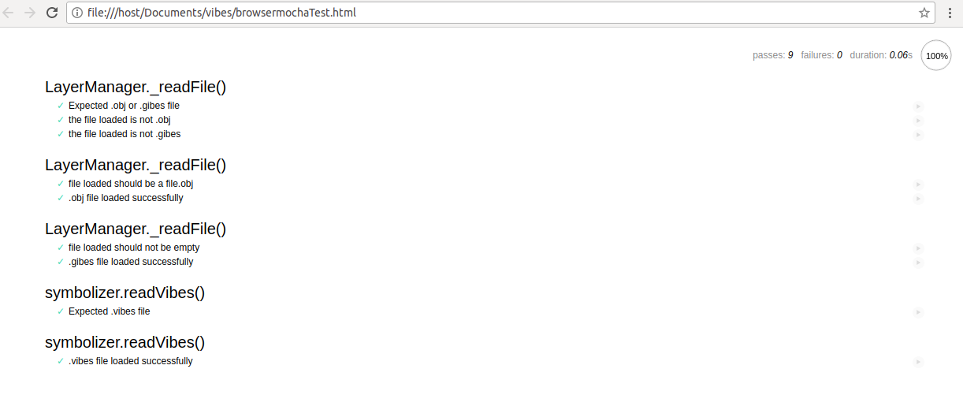
Unit Tests
NodeJs
Mocha javascript testing framework for
BDD (Behavior Driven Development ) interface
(syntax :describe() it(),beforeEach(), and afterEach()..)
Chai assertion library
Karma a test runner for JavaScript
can be integrated with Travis
Web Browser Firefox,Chrome.
Notes:
el hadi

Slide 30
Functional Tests
Tests for initial view
Tests for .obj
Drag & Drop, click/selection of object, keyboard move, delete layer, open/close symbolizer, display shadow, folders parameters, save/load style, save position/.GIBES
Tests for BATI3D
load BATI3D, … (same as .obj)
Tests for BDTOPO
load BDTOPO, … (same as .obj)
Tests for camera
parameters value
During the development, a test protocol was created to make sure that the developed functionalities working well.
Notes:
el hadi

Slide 31


Continuous Integration & Deployment
Tests run with TravisCI
Deployment :
Github page on itownsresearch:
https://itownsresearch.github.io/2018_TSI_vibes/examples/vibesObj.html
Without node server
publish script (./publish.sh at root folder)
arnaudgregoire/
vibes
push
itownsresearch/
vibes
build dist
commit dist folder
Notes:
ludivine/arnaud

Slide 32

Conclusion
GENERAL REVIEW
PERSONAL REVIEW
LIMITS & PERSPECTIVES

Slide 33

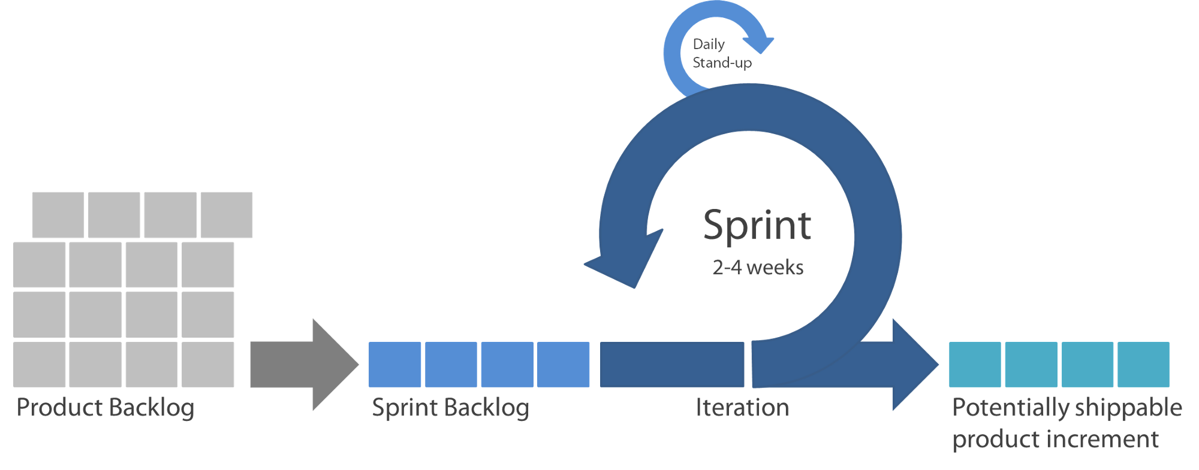
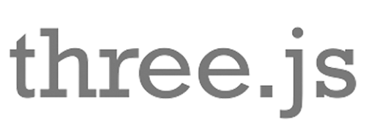
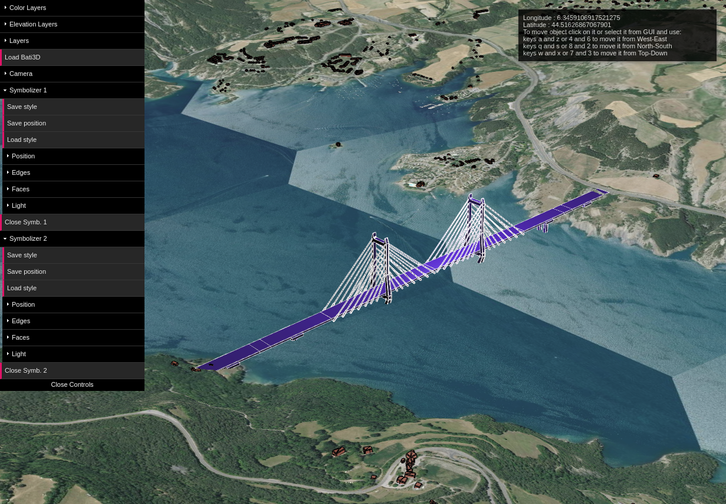
General review
https://github.com/itownsResearch/2018_TSI_vibes
Notes:
arnaud

Slide 34
Personal review
Houssem Adouni
El-Hadi Bouchaour
Arnaud Grégoire
Rose Mathelier
Laurie Nino
Adel Ouhabi
Ludivine Schlegel

Slide 35
Limits and perspectives
Challenges :
Sketchy stylization not optimized because of near/far problems
Shadows visual aspect perfectible
Perspectives :
Apply shaders on faces for a personalized stylization
Add new loaders for different formats
Write more unit tests
Notes:
adel

Slide 36
Thanks for attention

